Slide 1
Sentiment analysis through twitter as a mechanism for assessing university satisfaction
Mubtasim Saadid Ahmed
ID: 20101488

Slide 2
Aims & Objectives
To identify the factors that influence the satisfaction of university students about their learning in virtual environments, through the sentiments analysis.
To understand the contribution that data science offers.
To explore large amounts of texts and establishing patterns.
To extract useful information in educational management using sentiments analysis.

Slide 3
Contributions
To identify which factors should be improved by the teacher in order to have a preponderant effect on improving student satisfaction and improving academic quality.

Slide 4
Methodology
Data Collection
Pre-Processing, analysis of sentiments polarization and data extraction
Development of the proposed model through Python in the JupyterLab environment
Results

Slide 5
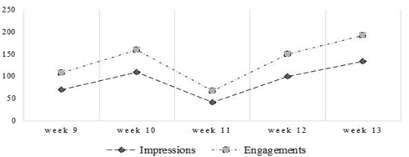
Methodology : Data Collection
The data is gathered throughout every class session, a non-experimental longitudinal type design was used for the data gathering.
Collection period is from week 9 to week 13.
It should be noted that the total impressions obtained in the 5 weeks of data acquisition were 455.
Fig: Interactions in the twitter account in the study period

Slide 6
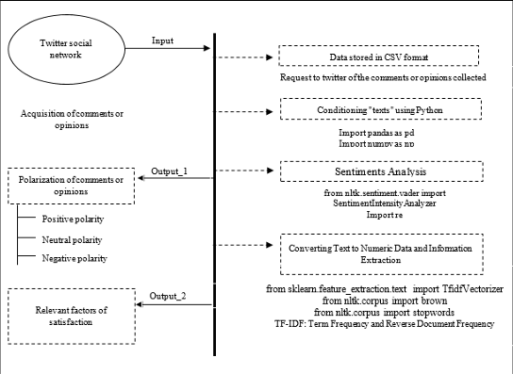
Methodology: Pre-Processing, analysis of sentiments polarization and data extraction
Data provided by the Twitter in file format with the extension "csv" will be conditioned to obtain the polarization of the comments.
Pre-processing consists of eliminating repeated texts, individual characters that are isolated, empty spaces that are found between text and text, as well as converting all texts to lower case.
Fig: Model used to identify relevant factors of university student satisfaction

Slide 7

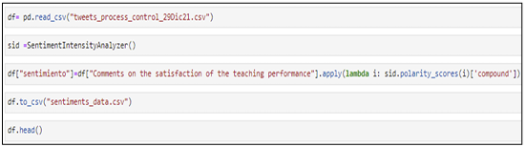
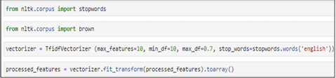
Methodology: Development of the proposed model through Python in the JupyterLab environment
In the first stage, we install the required libraries.
Once the data is read, we proceed to carry out the conditioning or pre-processing of the texts using NLTK, re libraries. A column will be generated on the right side of the texts, called “sentiment” where results of the sentiments contained in each tweet will be stored.
The programming code in which it seeks to extract the most relevant texts, contained in the sentiments tweets whose polarity is positive and negative, since these are closely related to the satisfaction and dissatisfaction of the teaching performance.
Fig: Script for reading twitter data in Python via JupyterLab
Fig: Script to obtain the sentiments contained in each Tweet
Fig: Script to perform word extraction using TF-IDF approach

Slide 8

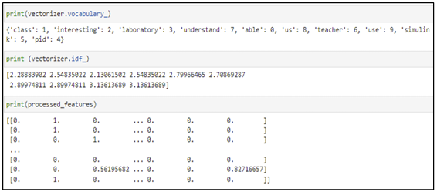
Methodology
4. Result :
The table shows polarity result obtained through Python and its libraries linked with the NLTK to obtain a benchmark on student satisfaction using text mining and NLP
It determined the relevant factors of virtual learning satisfaction, based on predominant text extraction techniques, generated under the TF-IDF approach
Fig: Distribution of the polarity of the sentiments contained in the tweets
Fig: Word extraction from tweets with positive polarity

Slide 9
Conclusions
The factors that influence university student satisfaction about their learning in virtual environments were identified, through sentiments analysis and the TF-IDF approach.
It is possible to obtain a reference point on student satisfaction using text mining and natural language processing (NLP) techniques.
It was identified that the relevant factors that contribute significantly to the satisfaction of virtual learning are those related to the teaching performance in the use of simulation tools that allow understanding the class sessions.

Slide 10
Limitations
Contextual Understanding : Reviews posted by user might lack context or subtle cues that might make the program difficult to interpret.
Data Imbalance : It can affect the program’s ability to learn sarcasm patterns adequately, leading to biased predictions favoring the majority class (non-sarcastic reviews).

Slide 11
Synthesis
To implement data science techniques and sentiments analysis relying on social networks.
The results obtained could be compared with those obtained through traditional techniques and instruments for evaluating teacher performance satisfaction.

Slide 12
“The End”

